Slide 1
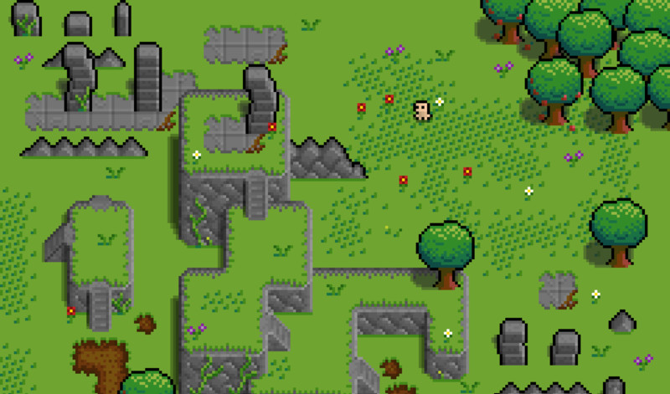

Green Sky Games
1 Bidhan / 2 Todd / 2+ Alex / 3 Mark / 4 Shan / 5 Hengyi / 6 Liz

Slide 2

01
Game Story
You could enter a subtitle here if you need it

Slide 3
BREAKING RED

Slide 4
OUR GOALS
Story
Combat
Scenery
A cohesive story that follows the main character, a parody of Little Red Riding Hood.
Red will be able to fight her foes in the forest wielding her trusty walking stick.
The forest of Red’s youth will be an explorable scene where the forest denizens hide.

Slide 5
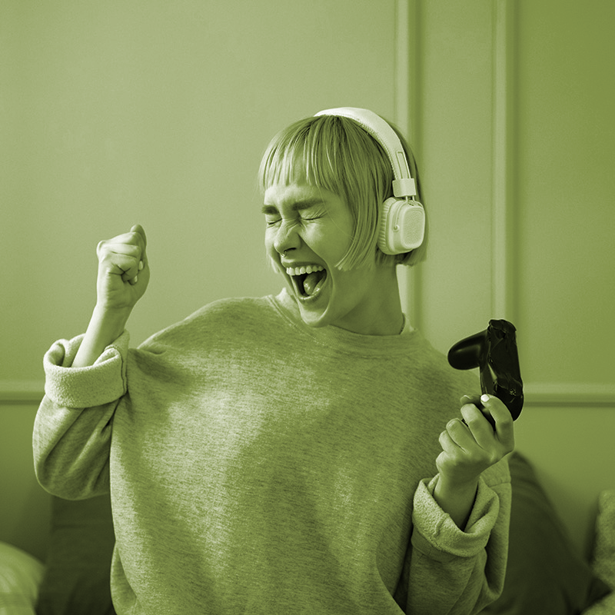
The Story of Breaking Red
“Once upon a time, Little Red Riding Hood visited her Grandmother’s house, only to find her… murdered. Who could have committed such a heinous act in the forest that Red grew up in?”
“No longer the scared girl of her youth, it’s up to Red to find out who killed Grandmother and bring them down.”

Slide 6
02
About Us
Hello, from Green Sky Games!

Slide 7
OUR TEAM
Bidhan
Todd
Alex
TL1
TL2
TL2+
Mark
Shan
Hengyi
Liz
TL3
TL4
TL5
TL6

Slide 8
03
Storyboard
You could enter a subtitle here if you need it

Slide 9
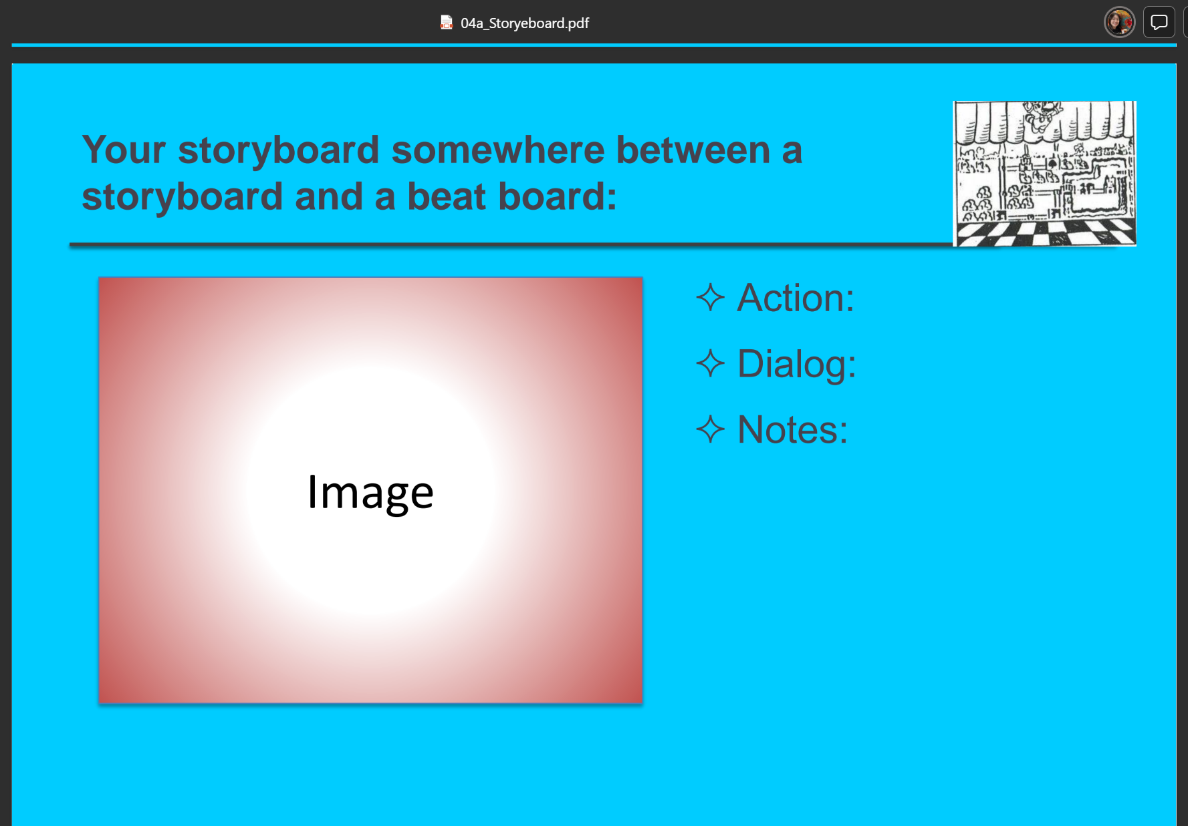
Scene 1: Main Menu
Action:
Selection of starting or loading a game.
Notes:
Background music playing while menu is displayed.

Slide 10
Scene 2: Character creator
Action:
Player chooses different options for character stats from a selection of available options.
Notes:
Background music playing while menus are displayed.

Slide 11
Scene 3: Prologue to game
Action:
Full screen wall of text that displays the start to the storyline.
Dialogue:
There will be text displayed on the screen for the player to read, as well as a voiceover for players who don’t want to.

Slide 12
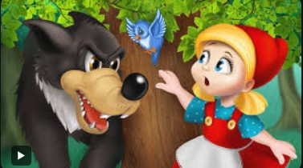
Scene 4:Play tutorial scene
Action:
While traveling from Grandmother’s house, Red encounters The Wolf, her mortal enemy.
Dialogue:
After confronting The Wolf and remembering their bad blood, neither backs down, and they come to blows.
After being defeated, the Wolf reveals he could not have been the murderer as the REAL murderer had the scent of a human.
Notes:
Text and arrows written on the ground. Navigation and combat controls are shown on screen and a direction is given to the first NPC encounter.

Slide 13
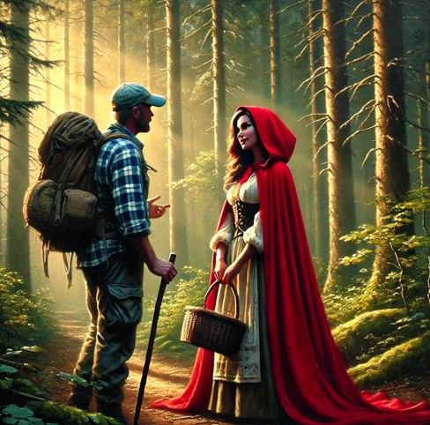
Scene 5: Enter the Forest
Action:
After defeating her old enemy The Wolf, Red realizes she hasn’t gotten her man. She sets off into the forest in search of the human that killed Grandmother.
Soon, she encounters The Hiker, a friendly face in the forest.
Dialogue:
The Hiker: “Hello there, fellow traveler! Fine day we’re having, isn’t it? Say, you haven’t seen a Cat around here, have you?”
Notes:
Clues from NPCs may not be obvious and must be read from the text.

Slide 14
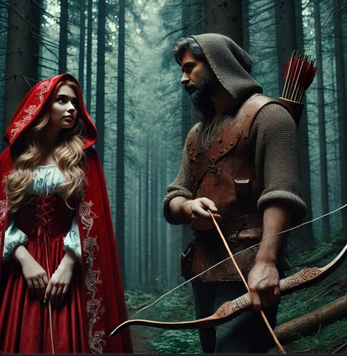
Scene 6:Explore the Forest
Action:
Red Riding Hood now knows the story isn’t going to be so simple. With five different suspects, any of whom could be the killer, she must explore the world in order to be certain about who killed Grandmother.
This leads her to The Hunter, an angry, temperamental human in the forest.
Dialogue:
The Hunter: “You and your Grandmother never belonged in these woods! Putting up no hunting signs like you own the place! Well, me and the Axman had a deal with Grandmother! When she bit it, I get full hunting rights to her property! And if she’s gone, YOU’RE all that’s in my way!”

Slide 15
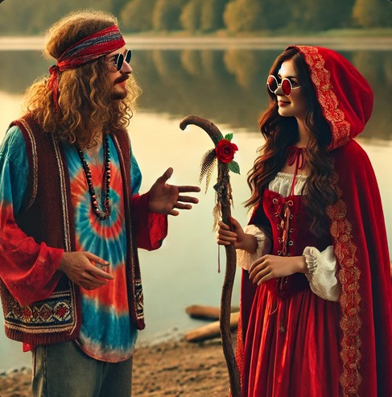
Scene 7:Enter the Lake
Action:
With the mystery unsolved, Red must continue on exploring, until she finds the Lake.
Red finds the Hippie, an old friend of hers, not far from the Lake where he’s out enjoying nature.
Dialog:
The Hippie: “What? I didn’t do it, man. You know me, Red, don’t you? Maybe you should ask The Wizard? He had a big fight with Grandmother a little while back.”
Notes:
Despite claiming innocence, the Hippie will have the same profile as the other humans. His friend The Fish, however, will provide more useful clues.

Slide 16
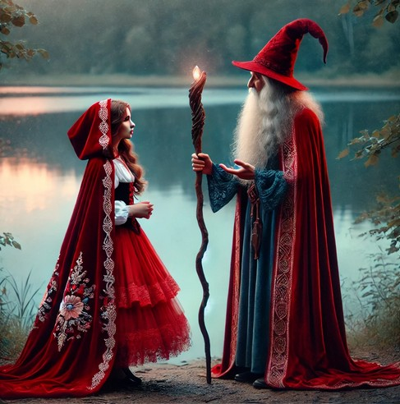
Scene 8:Explore the Lake
Action:
Red goes off in pursuit of the Wizard after being put on his trail by her old friend, The Hippie.
Red traverses a simple maze as she seeks out The Wizard in his relatively hidden location.
Dialog:
The Wizard: “What? Your Grandmother is… dead? That is… awful news. Please… I would like to be alone for a while…”
Notes:
The Wizard will refuse help unless Red beats it out of him, but he will provide his clue to her regardless. If Red fights him, he will use his magic to reveal The Cat is the only witness to the crime.

Slide 17
Scene 9: The Final Area
Action:
Having followed the trail of clues, Red is forced to admit only one suspect can be the murderer. She sets out to meet them in the only place they can be…
Dialog:
The Killer: “I TOLD Grandmother! And now! I’m gonna tell you too!”
Notes:
Clearly this shouldn’t be revealed, but if you study this presentation hard enough, you can probably figure out which NPC is the actual murderer.

Slide 18
Scene 10: Victory screens
Action:
With The Killer dealt with, Red Riding Hood finishes her story in the epilogue. Title credits roll over the scene of her victory.
Notes:
Three possible endings are planned depending on what has been achieved. This will depend on how many, if any, clues Red Riding Hood managed to gather before finding and confronting The Killer.

Slide 19
04
Data Flow Diagrams
You could enter a subtitle here if you need it

Slide 20
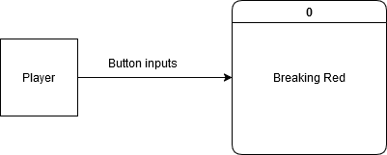
CONTEXT DIAGRAM

Slide 21
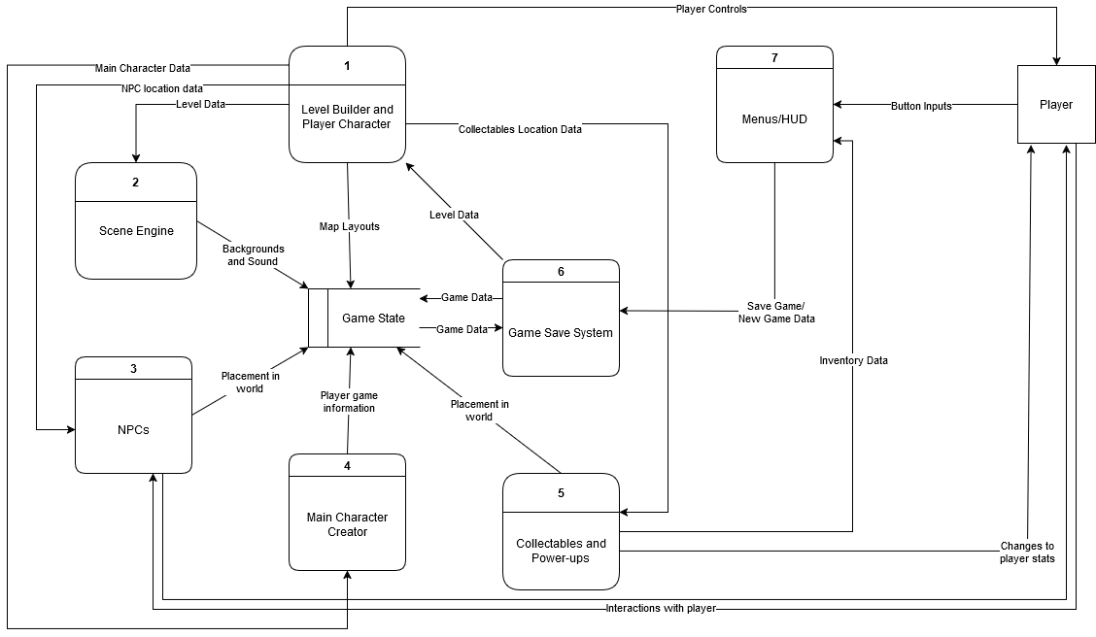
DIAGRAM 0

Slide 22
05
Global Use Case
You could enter a subtitle here if you need it

Slide 23
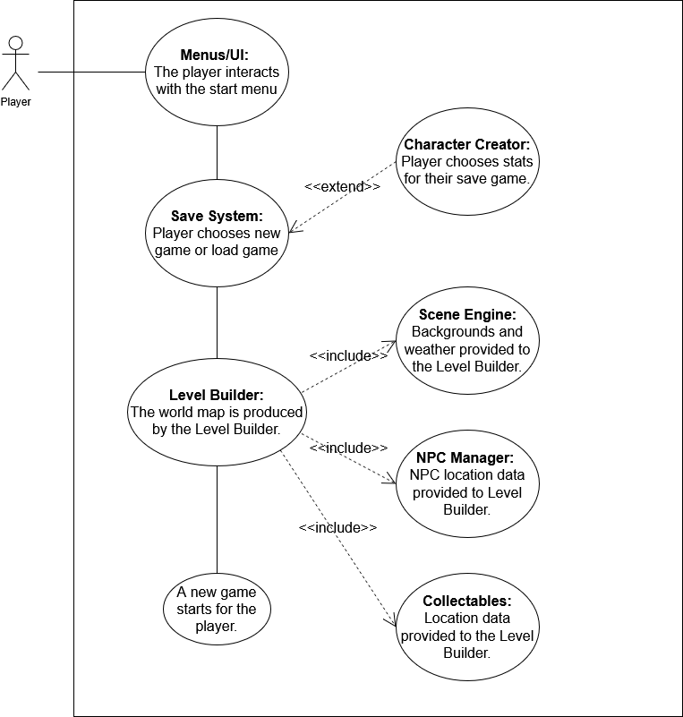
GLOBAL USE CASE

Slide 24
06
Individual Use Case
You could enter a subtitle here if you need it

Slide 25
Liz– feature

Slide 26
Liz Use Case

Slide 27
Bidhan – feature

Slide 28
Bidhan Use Case

Slide 29
Mark – feature

Slide 30
Mark Use Case

Slide 31
Alex– LEVEL LOADER

Slide 32
Alex Use Case

Slide 33
Hengyi – SCENE ENGINE

Slide 34
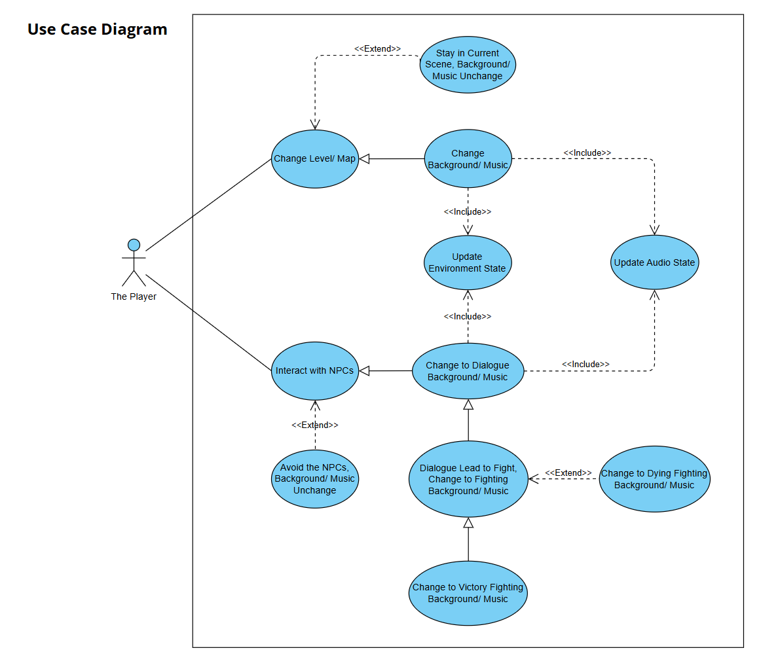
Hengyi Use Case

Slide 35
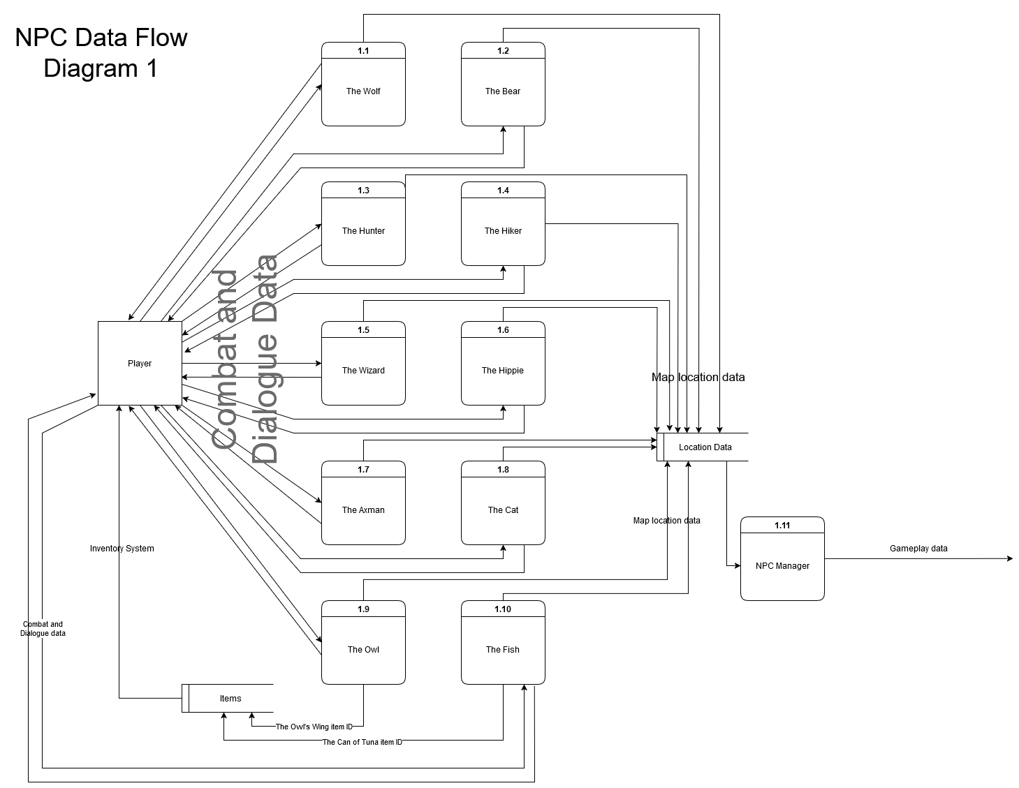
Todd – NPCs/Story Diagram 1 TL2+

Slide 36
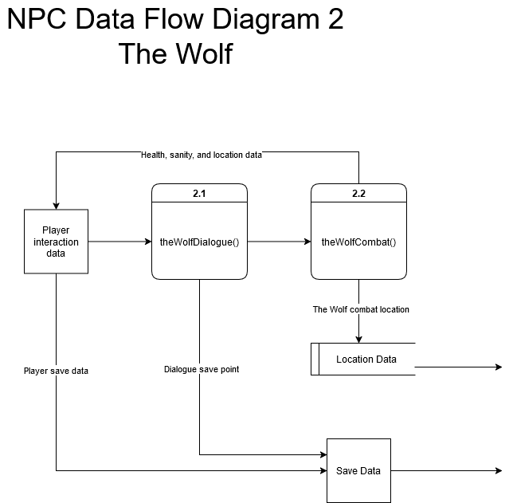
Todd – NPCs/Story Diagram 1 TL2+

Slide 37
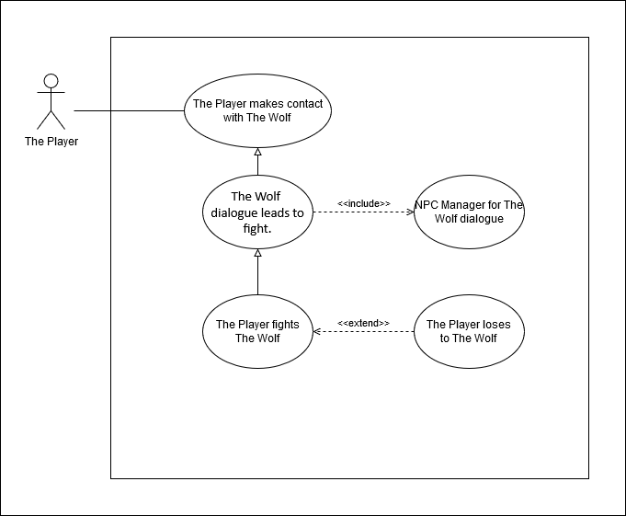
Todd - NPCs/Story Use Case TL2+

Slide 38
Todd – NPCs/Story Overview TL2+
Complexity: 9/10
Priority: 2
Though relatively complex due to creating a unique dialogue system that will be able to handle the flow of the story, the NPCs and story are lower priority than crucial systems such as the ability to move and attack.

Slide 39
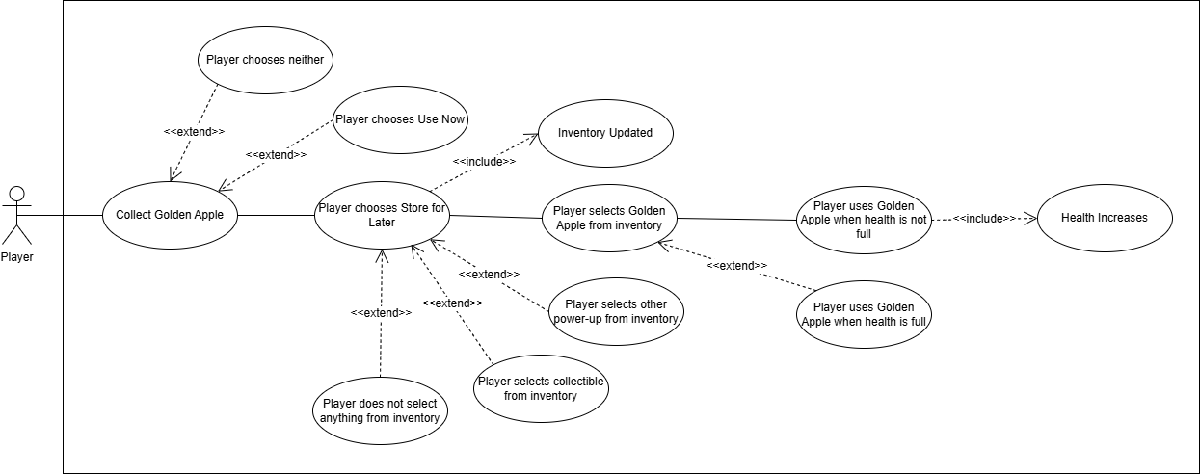
Shan - Use Case

Slide 40
Shan – Collectables,Power-Ups,Inventory
Place power-ups
Apply effects of power-ups to player
Enable placement of collectables and power-ups into inventory
Complexity: 6/10
Priority: 3 (nice to have)

Slide 41
THANKS!
?
Any Questions?

